Slide 1


VSB ENGINEERING COLLEGE
(AN AUTONOMOUS INSTITUTION)
REAL-TIME DATA-DRIVEN INTELLIGENT IOT-BASED WIND ENERGY MANAGEMENT SYSTEM
GUIDED BY:
PRESENTED BY:
MS . G . YASIKA Assistant Professor
JANARTHANAN. S
JAYARAJ. V
PRANAV. G

Slide 2
OUTLINE
1. Abstract
2. Objectives
3. Literature Survey
4. Introduction
5. Existing System
6. Disadvantages
7. Proposed System
8. Block diagram
9. Advantages and Applications
10. Arduino IDE
11. Arduino
12. Results and Discussion
13. Output
14. Conclusion
15. Reference

Slide 3
ABSTRACT
This project aims to develop an intelligent renewable energy system that utilizes wind energy for power generation and a battery for energy storage. The system is designed to monitor and control key parameters such as wind energy, battery voltage, and temperature, ensuring optimal energy management.
Voltage sensors track the voltage levels of both the wind generator and the battery, while a temperature sensor monitors wind conditions for efficient energy production. The system includes a power regulation mechanism to ensure stable energy output and an inverter to convert DC to AC for powering connected loads.
A relay is used to control the operation of both the wind turbine and the load. The system also integrates an interface that provides real-time data on wind energy, battery status, and system operations, ensuring that users can easily monitor and manage the system. With remote monitoring and control capabilities, users can turn the wind turbine and load on or off based on the data, optimizing energy efficiency.

Slide 4
OBJECTIVE
Harness Wind Energy: Capture and utilize wind energy for power generation, contributing to renewable energy production.
Optimize Energy Storage: Store excess energy in a battery to ensure reliable power supply during variable wind conditions.
Monitor Key Parameters: Continuously monitor wind energy, battery voltage, and temperature for efficient system operation.
Control Energy Distribution: Enable automatic and manual control of the wind turbine and load through a relay for adaptive energy management.
Real-time Monitoring and Control: Provide users with an interface for remote monitoring and control via IoT, optimizing system performance and energy efficiency.

Slide 5
LITERATURE SURVEY
S.NO | TITLE | AUTHOR | PUBLICATION AND YEAR | DESCRIPTION
1 | Wind turbine cost reduction: A detailed bottom-up analysis of innovation drivers | A. Elia, M. Taylor, B. Ó Gallachóir, F. Rogan | Energy Policy, vol. 147, Dec. 2020 | This paper provides a comprehensive bottom-up analysis of the factors driving cost reductions in wind turbine technology. It explores technological innovations and policy mechanisms that contribute to reducing the overall cost of wind turbines, focusing on efficiency improvements and scaling effects in the wind energy sector.
2 | Techno-economic optimisation of small wind turbines using co-design on a parametrised model | J. D. M. De Kooning, A. E. Samani, S. De Zutter, J. De Maeyer, L. Vandevelde | Sustainable Energy Technologies and Assessments, vol. 45, Jun. 2021 | The paper focuses on the techno-economic optimization of small wind turbines by employing a co-design approach. The authors utilize a parametrized model to optimize the performance and cost-effectiveness of small-scale wind turbine systems, ensuring better efficiency and more sustainable energy generation for residential and small industrial use.
3 | Improved hardware implementation of a TSR based MPPT algorithm for a low-cost connected wind turbine emulator under unbalanced wind speeds | D. Zouheyr, B. Lotfi, B. Abdelmadjid | Energy, vol. 232, Oct. 2021 | This paper presents an improved hardware implementation of the Tip-Speed Ratio (TSR) based Maximum Power Point Tracking (MPPT) algorithm for a low-cost wind turbine emulator. It specifically addresses the challenges posed by unbalanced wind speeds and aims to enhance the performance and efficiency of wind turbines under varying environmental conditions.

Slide 6
LITERATURE SURVEY
S.NO | TITLE | AUTHOR | PUBLICATION AND YEAR | DESCRIPTION
4 | Development of a wind turbine simulator to design and test micro HAWTs | K. S. Ajirlo, P. H. Tari, K. Gharali, M. Zandi | Sustainable Energy Technologies and Assessments, vol. 43, Feb. 2021 | This research introduces a wind turbine simulator designed to test and optimize micro Horizontal Axis Wind Turbines (HAWTs). The simulator is crucial for designing small-scale wind turbines, particularly for residential or off-grid energy solutions, providing an efficient platform for testing various turbine configurations and performance under different conditions.
2 | A state-of-the-art review of the vibration and noise of wind turbine drivetrains | Z. Xu, J. Wei, S. Zhang, Z. Liu, X. Chen, Q. Yan, et al. | Sustainable Energy Technologies and Assessments, vol. 48, Dec. 2021 | This review paper provides a thorough analysis of the vibration and noise characteristics of wind turbine drivetrains. It discusses the sources of vibrations and noise, their impact on turbine performance and durability, and the advancements in noise reduction techniques, contributing to the improvement of wind turbine efficiency and reducing environmental and operational disturbances.

Slide 7

INTRODUCTION
The growing demand for sustainable and renewable energy sources has led to the exploration of wind power as an alternative energy solution. Wind energy, when harnessed efficiently, can significantly contribute to reducing reliance on non-renewable sources of energy.
To make wind power viable in various applications, effective systems for monitoring, controlling, and optimizing energy production are essential.
This project aims to develop an intelligent renewable energy system that not only harnesses wind energy for power generation but also ensures optimal storage and management of energy through integration with a battery system.
The system is designed to continuously monitor key parameters such as wind energy generation, battery voltage, and temperature. This ensures that the system operates at peak efficiency while minimizing energy wastage.

Slide 8
EXISTING SYSTEM
Existing wind energy systems primarily focus on basic components like wind turbines, batteries, and inverters for energy generation and storage, but they often lack advanced features for efficient energy management and real-time monitoring.
These systems typically offer limited monitoring capabilities, making it difficult to track essential parameters such as wind speed, battery voltage, and temperature in real-time, which reduces overall efficiency and performance.
Control is generally manual, requiring users to adjust the system settings physically, which is inefficient and time-consuming, especially in remote or automated environments.
Many systems struggle with intelligent energy distribution, leading to underutilization of the battery or inefficient power delivery to the load. Power conversion is often rudimentary, without adapting to real-time demands, resulting in potential energy loss

Slide 9
DISADVANTAGES
Limited Monitoring: Existing systems lack real-time tracking of key parameters like wind speed, battery voltage, and temperature, reducing efficiency and system performance.
Manual Control: Many systems require manual adjustments for operation, which can be time-consuming and inefficient, especially in remote or automated settings.
Inefficient Energy Distribution: Without intelligent energy management, existing systems often fail to optimize energy flow, leading to underutilized battery capacity and power loss.

Slide 10
PROPOSED SYSTEM
The proposed system integrates several advanced modules to enhance wind energy management. Using an Arduino Uno as the central controller, the system monitors critical parameters such as wind energy, battery voltage (via voltage sensors), and temperature (via a temperature sensor).
These parameters are displayed in real-time on an LCD, providing users with up-to-date insights. The system includes a DC-to-DC converter for power regulation, and an inverter for converting DC to AC power, ensuring efficient energy delivery to the load.
A relay controls the on/off status of both the wind turbine and the load, enabling automated or remote control. The system is integrated with an IoT platform for remote monitoring and control, allowing users to manage and optimize energy distribution through real-time data, enhancing efficiency and usability.

Slide 11
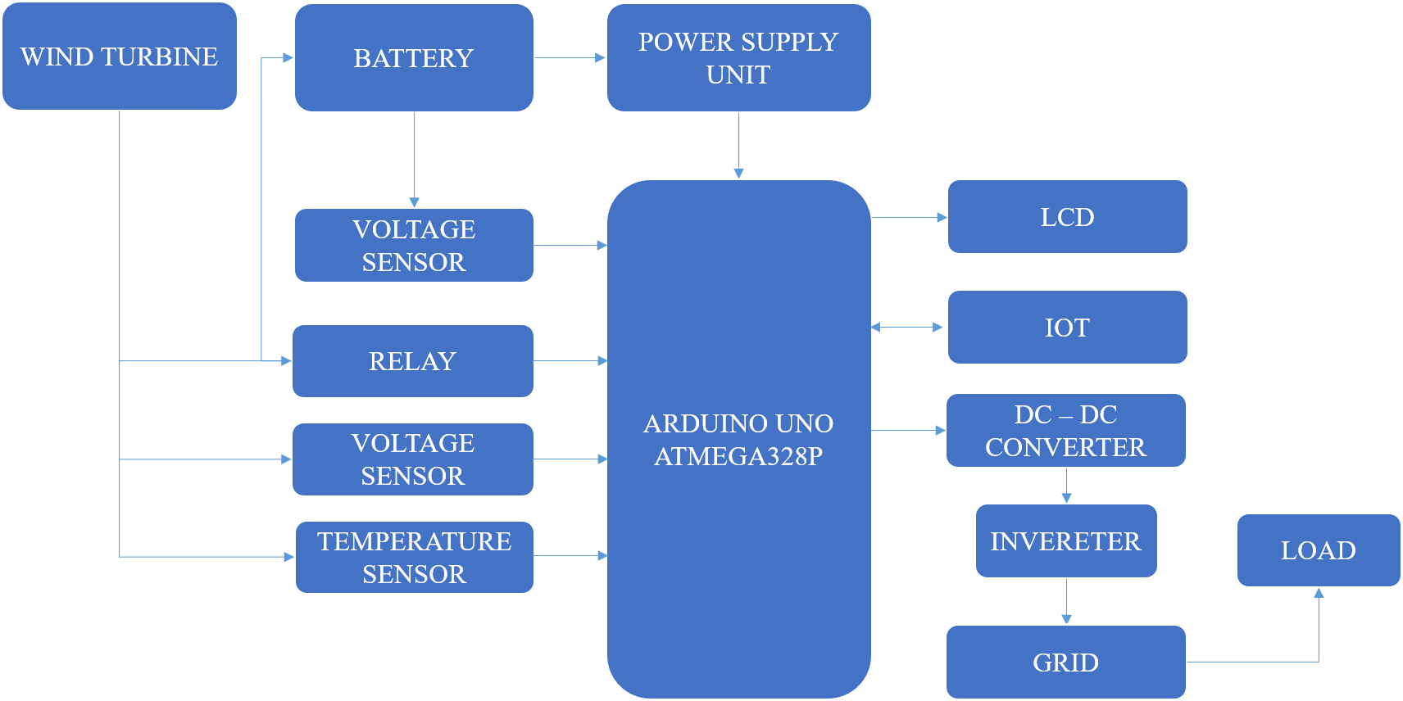
BLOCK DIAGRAM

Slide 12
ADVANTAGES & APPLICATIONS
ADVANTAGES:
Efficient Energy Management: The system optimizes wind energy generation, storage, and distribution, minimizing energy wastage.
Remote Monitoring and Control: IoT integration allows users to monitor and control the system remotely, enhancing convenience and flexibility.
Real-time Feedback: The LCD display provides immediate information on system parameters, enabling quick decisions for optimal performance.
APPLICATIONS:
Renewable Energy Generation: Suitable for homes, farms, and remote areas to harness wind energy for electricity.
Off-grid Power Systems: Ideal for regions without access to the main power grid, providing a sustainable energy solution.
Smart Grids: Can be integrated into smart grid systems to optimize energy usage and distribution in wind-based power networks.

Slide 13
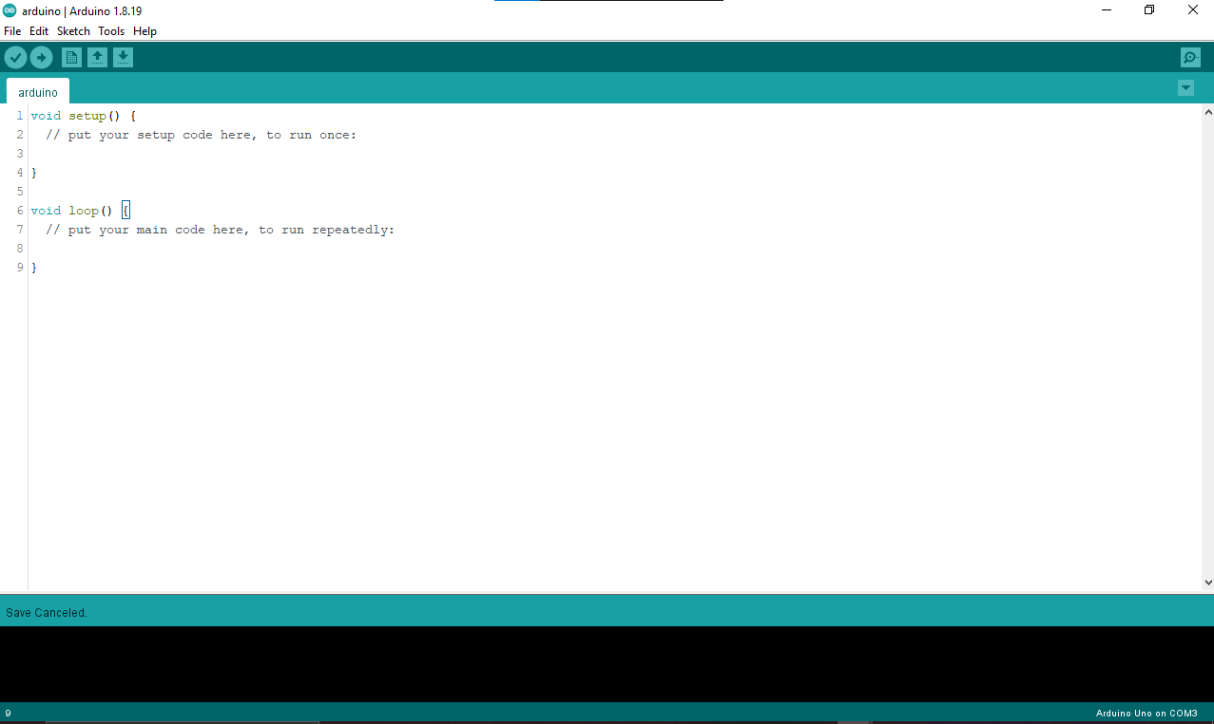
ARDUINO IDE
The Arduino IDE (Integrated Development Environment) is an open-source software used for writing, compiling, and uploading code to Arduino microcontrollers. It supports C/C++ programming languages and provides a simple interface for creating and testing Arduino projects, known as "sketches." The IDE features syntax highlighting, error checking, and access to a vast library of pre-written code for various sensors and peripherals. It is widely used by hobbyists, students, and professionals for rapid prototyping and embedded system development.

Slide 14
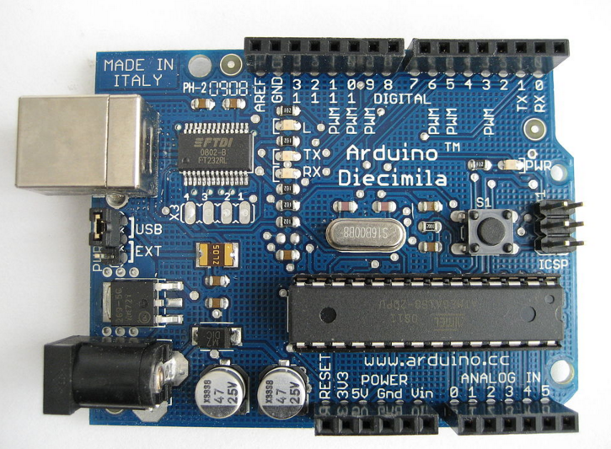
ARDUINO
Arduino is an open-source prototyping platform based on easy-to-use hardware and software.
Arduino boards are able to read inputs - light on a sensor, a finger on a button, or a Twitter message - and turn it into an output - activating a motor, turning on an LED, publishing something online.
You can tell your board what to do by sending a set of instructions to the microcontroller on the board.
To do so you use the Arduino programming language (based on Wiring), and the Arduino Software (IDE), based on Processing.

Slide 15
RESULTS & DISCUSSION
Smart Energy Management: The system dynamically optimized wind energy generation using sensors and automation, enhancing efficiency and reducing mechanical strain.
IoT-Based Monitoring and Control: Real-time data via ESP8266 allowed remote control and monitoring through platforms like Blynk and ThingSpeak for predictive maintenance.
Simulation and Hardware Validation: Proteus simulations verified the circuit before implementation, and Arduino-based logic ensured accurate control and sensor integration.
Scalability and Real-World Application: The modular design supports deployment in rural or off-grid areas, offering a low-maintenance and user-friendly renewable energy solution.

Slide 16
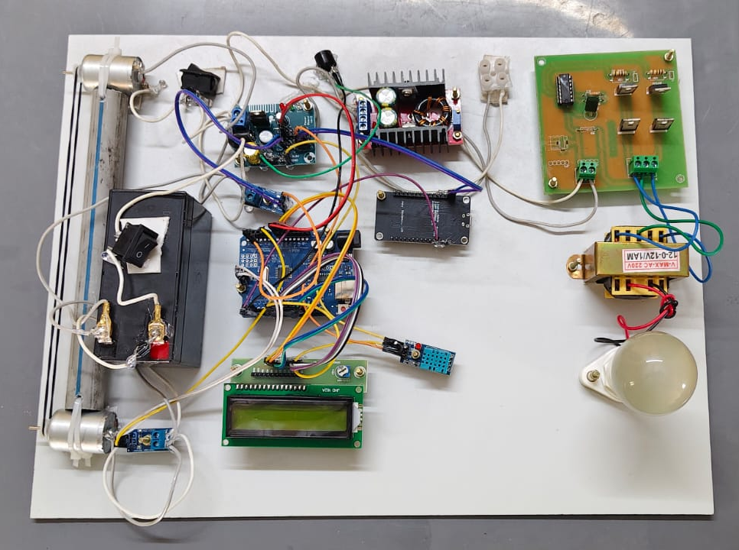
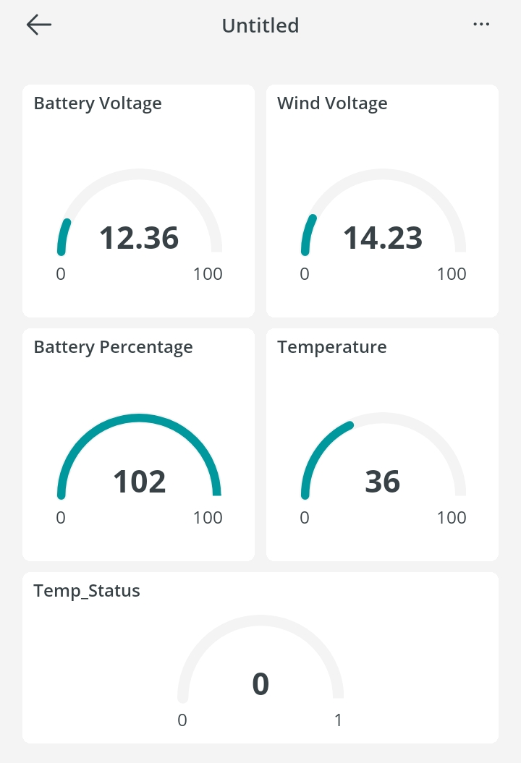
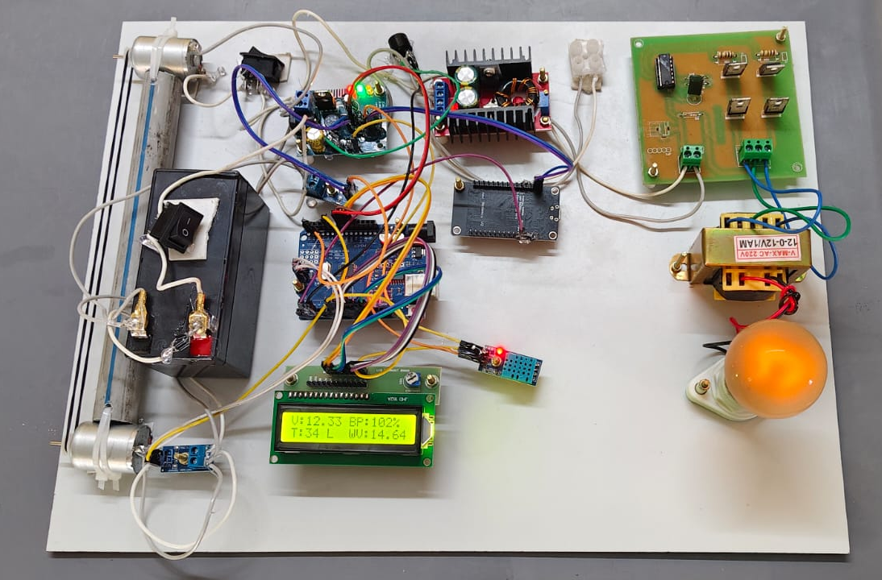
OUTPUT
Iot Kit Image (Off)
Iot Application Monitoring Interface
Iot Kit Image (On)

Slide 17
CONCLUSION
This project successfully demonstrates the integration of wind energy generation with advanced energy management systems, offering a highly efficient and automated solution for renewable energy utilization.
By incorporating real-time monitoring, intelligent control, and IoT integration, the system ensures optimal performance, reduces energy wastage, and provides users with greater control and flexibility through remote monitoring and the LCD interface.
The system's ability to efficiently manage energy storage and distribution makes it ideal for off-grid applications, smart grids, and sustainable energy solutions in remote areas.
This project contributes to enhancing the efficiency and accessibility of renewable energy systems, promoting a more sustainable and environmentally friendly future.

Slide 18
REFERENCE
A. Elia, M. Taylor, B. Ó Gallachóir and F. Rogan, "Wind turbine cost reduction: A detailed bottom-up analysis of innovation drivers", Energy Policy, vol. 147, Dec. 2020.
J. D. M. De Kooning, A. E. Samani, S. De Zutter, J. De Maeyer and L. Vandevelde, "Techno-economic optimisation of small wind turbines using co-design on a parametrised model", Sustain. Energy Technol. Assessments, vol. 45, Jun. 2021.
D. Zouheyr, B. Lotfi and B. Abdelmadjid, "Improved hardware implementation of a TSR based MPPT algorithm for a low cost connected wind turbine emulator under unbalanced wind speeds", Energy, vol. 232, Oct. 2021.
K. S. Ajirlo, P. H. Tari, K. Gharali and M. Zandi, "Development of a wind turbine simulator to design and test micro HAWTs", Sustain. Energy Technol. Assessments, vol. 43, Feb. 2021.
Z. Xu, J. Wei, S. Zhang, Z. Liu, X. Chen, Q. Yan, et al., "A state-of-the-art review of the vibration and noise of wind turbine drivetrains", Sustain. Energy Technol. Assessments, vol. 48, Dec. 2021.

